Slide 1
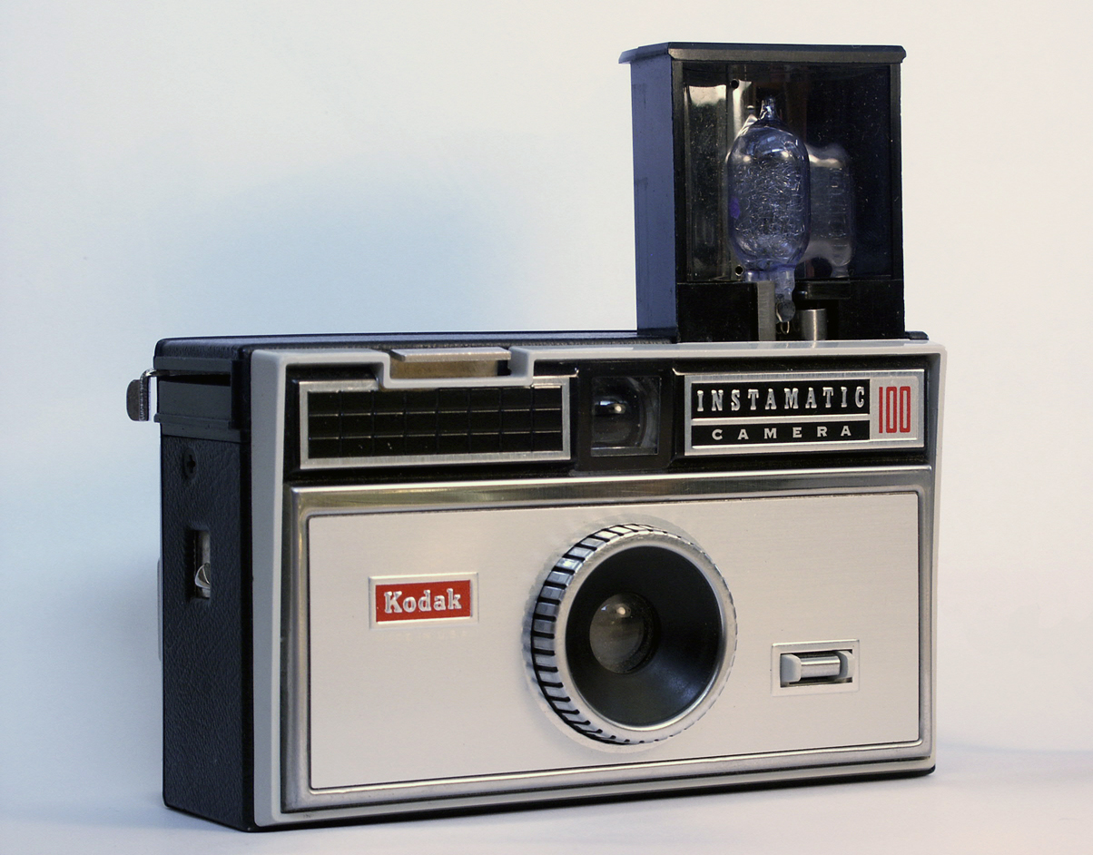
Let’s take a class picture!

Slide 2


Fundamentals of RM
RM System and Process
Leadership in RM
Incident Investigation
RM Tools & Challenges
RM in Industry
People & Org.
Application and Perspectives
On Becoming a
Leader in Risk Management
ENGG404 - Lecture
Final Lecture on Career Lessons

Slide 3
Our Personal Lessons To You:
A few pointers to help you as you begin your careers:
Manage your Business:
  The Engineer’s Survival Guide
  Leadership in Risk Management
Manage Your Relationships:
  Do Your Job
  Work With Your Direct Supervisor:
Be a Professional!
  Establish your professional values:
    “Integrity. Initiative. Innovation. Industriousness.”
  Be Competent
    The Quebec Bridge Loss Incident
Some Guidance - Leadership in RM and Your Career:
Final Lecture on Career Lessons
3
Notes:
3

Slide 4
1) Manage Your Business!
Can you become and be a “Leader in Risk Management?”
If you were asked these questions, how would you reply?
Q: “What is a Manager? What is a Leader?”
Q: “What is Leadership in Risk Management?”
… that’s what this course is about!
Manager | Leader
Keeps the organization going. | Leaders make things happen (in a principled manner) that would not have happened otherwise.
Maintains the “status quo”. | Envisions how the organization can improve, and works to improve and advance the organization.
Is satisfied with current performance. | Is proactive in “making things happen”.
Final Lecture on Career Lessons
4
Notes:
4

Slide 5

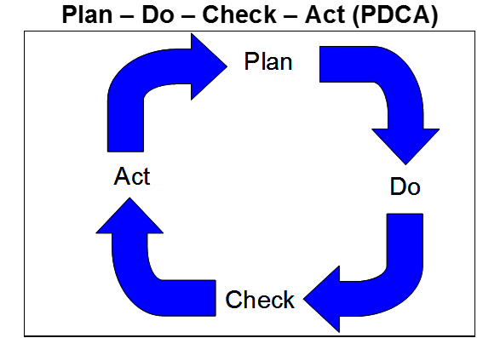
2) Manage Your Relationships!
Do your job:
You have professional responsibilities and are accountable!
Identify your objectives!
Execute all steps of the fundamental function of management.
Final Lecture on Career Lessons
5
Notes:
5

Slide 6
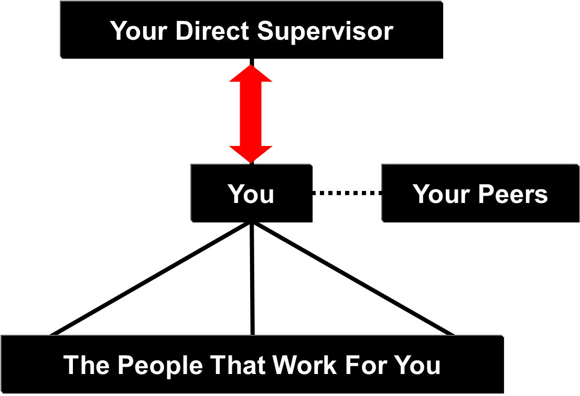
2) Manage Your Relationships!
Some practical advice to work with your direct supervisor:
Ensure you are meeting expectations, and managing your responsibilities such that there are “no surprises”!
Take the initiative to communicate. Seek clarity when directions clash with ethics, values, policies, etc. Keep your supervisor informed especially when things are not going per the plan.
Supervisors want solutions, not excuses, and not more problems.
FYI: Bosses want solutions! NOT excuses and
NOT more problems!
Final Lecture on Career Lessons
6
Notes:
6

Slide 7
3) Be a Professional, Be a Leader!
Establish your professional values:
Integrity: two “ideas” about of integrity!
Initiative: anticipate and get ahead of what is needed,
and on what you can deliver!
Innovation: use your smarts to develop solutions.
Industriousness: put in the effort, but be smart about your work!
Final Lecture on Career Lessons
7
Notes:
7

Slide 8
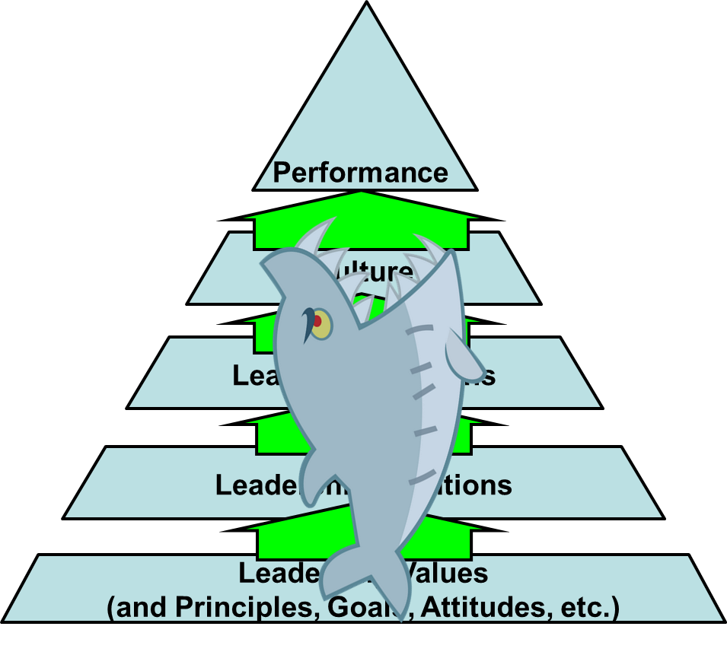
3) Be a Professional, Be a Leader!
Performance is built on culture …
And culture is built by YOU!
Final Lecture on Career Lessons
8
Notes:
8

Slide 9
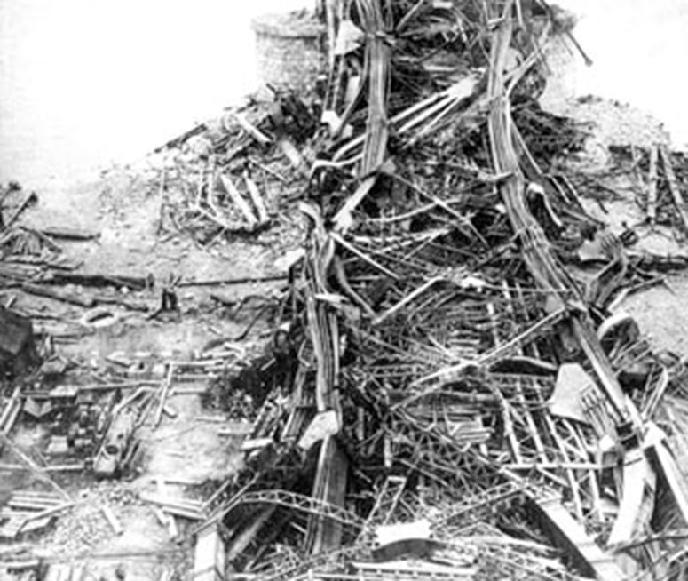
3) Be a Professional, Be a Leader!
Be competent in your career!
Be proud of your profession’s achievements and contributions
to society, but also of your own personal triumphs!
But don’t let your pride and arrogance get ahead of yourself.
You do not want to be the author of a case study.
Recall The Quebec Bridge Disaster, near Quebec City, August 29, 1907:
Reputations ruined
Capital investment lost
Two years to clean up.
75 workers were killed
… and the significance of your Iron Ring
Final Lecture on Career Lessons
9
Notes:
9

Slide 10
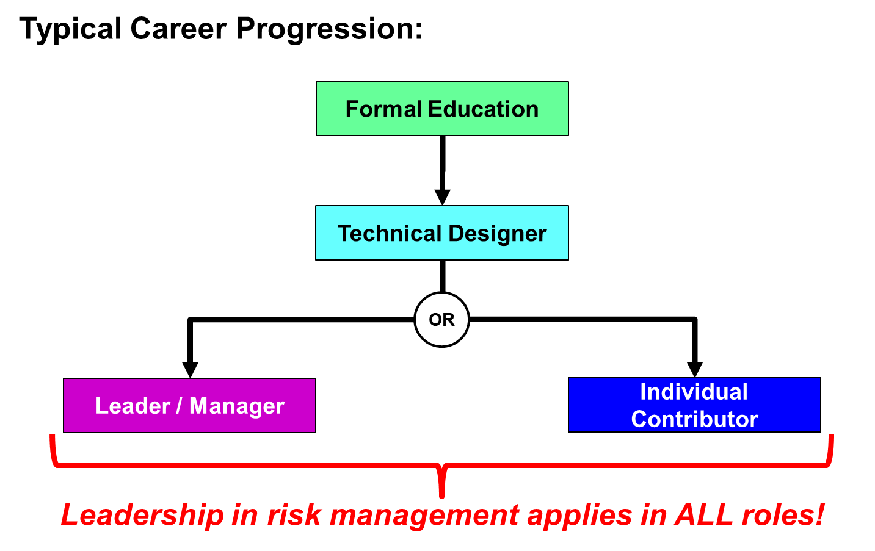
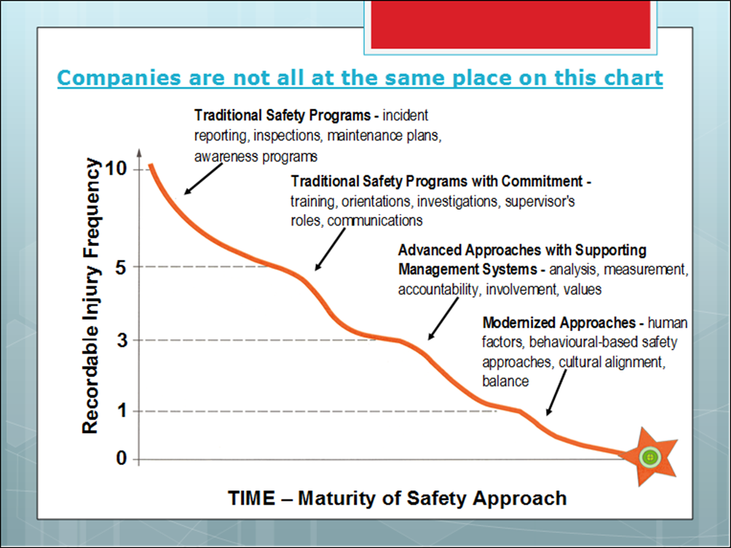
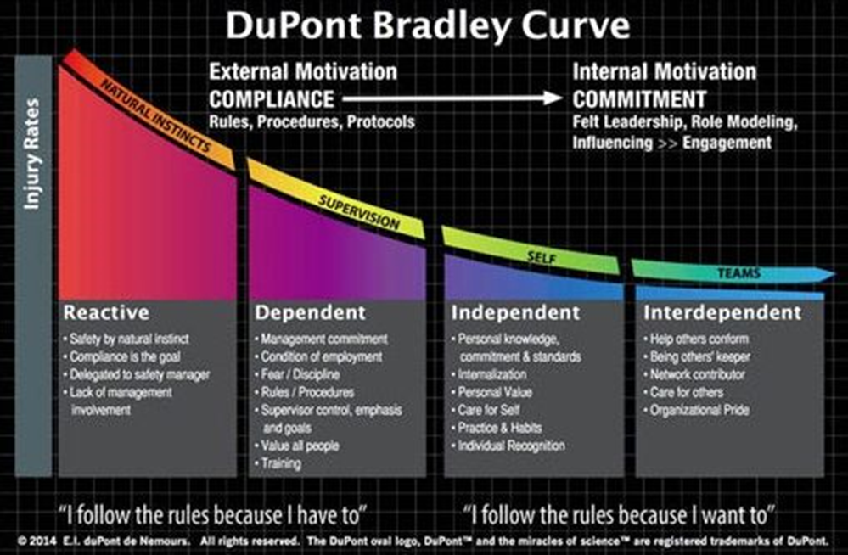
Some Guidance for You:
This course is based on the “real workplace” experience with well over 150 expertise-years in industry. Some guidance for you as you embark on your career:
Your success (or failure) in your career rests on:
Your leadership skills (or lack of) in RM.
Your desire to “be” an engineer, whether as a
leader/manager or individual contributor.
Leading organizations have been practicing
RM for >50 years, have benefitted from RM
as a competitive advantage, and continue to
evolve towards “Zero Incidents”.
Evolving organizations recognize that
excellence in RM is necessary to be
sustainable and to compete.
Excellence in safety and risk management will be core
to your career success …
If you don't "get it", you will not succeed!
Final Lecture on Career Lessons
10
Notes:
10

Slide 11
On Becoming a Leader in Risk Management!
This brings us to the conclusion of our lectures.
Your future employer will be well supported by your efforts
in safety and risk management.
Thank you for your participation, and for your commitment to learning and applying the principles of engineering safety and risk management in your careers.
We sincerely wish you the best of success on all of your final exams and for a bright future in your careers!
It truly has been a privilege teaching you, and learning together with you.
Thank you!
Dr. White, Dr. Macciotta, Professor Coles, Professor Winkel, & Professor Cocchio
Final Lecture on Career Lessons
11
Notes:
11
11

